Slide 1

AMAZON FINE FOODS RECOMMENDATION SYSTEM
CSCI B565 DATA MINING - FINAL PROJECT

Slide 2



MEET THE TEAM
Sasidev
Mahendran
(sasmahe@iu.edu)
Harshaavardhan Devaraj (hdevaraj@iu.edu)
Harish Raju
Ganapathi Senthilkumar
(hagana@iu.edu)

Slide 3
Presentation Outline
Project Description
Data Source
Data Pre-Processing
Visual EDA
Feature Engineering
Modelling
Analysis and Results
Problems faced
Conclusion
Future Scope

Slide 4
PROJECT DESCRIPTION
SECTION 1

Slide 5
PROJECT DESCRIPTION
Build a robust recommendation system.
Help the users select the products that they might like based on historical data and based on other similar users.
We will be using content based filtering and collaborative filtering.
Project aims to reduce the user’s time spent on searching a product by suggesting it in advance.
This will also be useful for the business owners to improve the sales by helping them cater to right audience.
We have also tried to incorporate many of the topics covered in the Data Mining course

Slide 6
DATA SOURCE & DESCRIPTION
SECTION 2

Slide 7
DATA SOURCE & DESCRIPTION
Primarily, we have used the “Amazon Fine Food Reviews” data set from Kaggle.
The details of the data set are as follows:
The reviews are dated from Oct 1999 - Oct 2012
The total number: 568,454 reviews
Number of users: 256,059 users
Total products: 74,258 products
Number of users with max reviews: 260 users with more than 50 reviews

Slide 8
DATA SOURCE & DESCRIPTION
The description of the data set is as follows:
Id - Row Id
ProductId - Unique identifier for the product
UserId - Unqiue identifier for the user
ProfileName - Profile name of the user
HelpfulnessNumerator - Number of users who found the review helpful
HelpfulnessDenominator - Number of users who indicated whether they found the review helpful or not
Score - Rating between 1 and 5
Time - Timestamp for the review
Summary - Brief summary of the review
Text - Text of the review

Slide 9
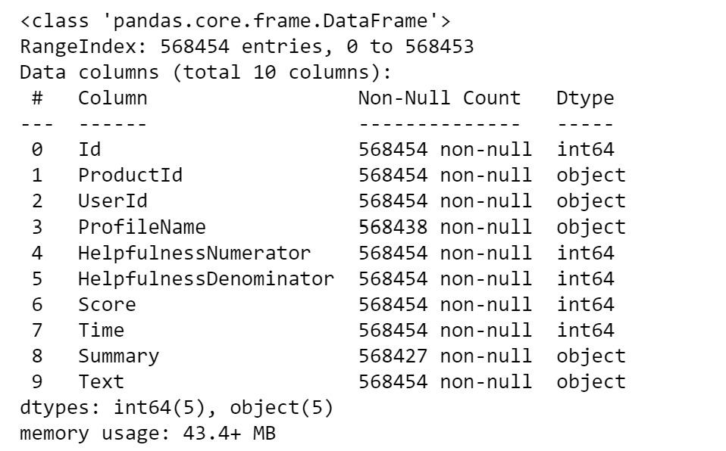
DATA SOURCE & DESCRIPTION
Data type of the columns

Slide 10
DATA PRE-PROCESSING
SECTION 3

Slide 11
DATA PRE-PROCESSING
The first step in this stage was basic data cleaning.
We found a few issues with the data set after the basic cleaning.
One issue was that there were multiple data instances of the same data with same product_id and user_id.
We overcame that by keeping a single instance of the data and neglecting the other instances.
The other issue we faced was the size of the data.
We used random sampling to select the input data without inducing bias, to address this issue.

Slide 12

VISUAL EDA
SECTION 4

Slide 13
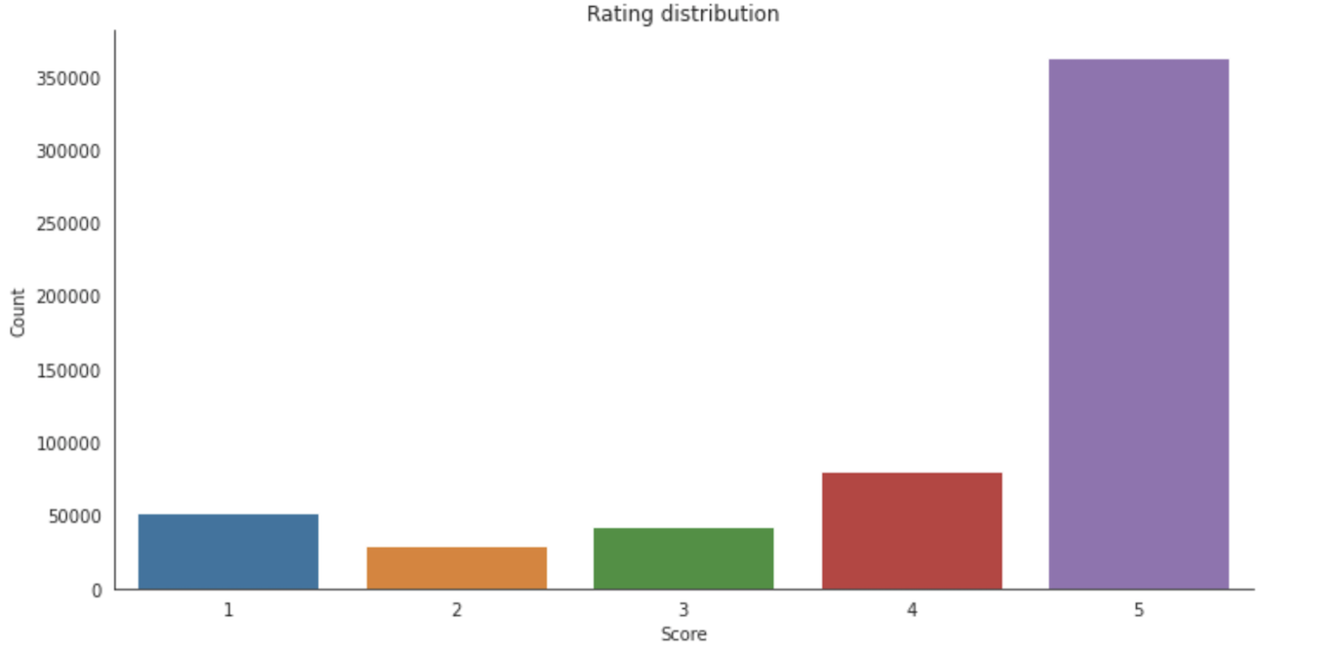
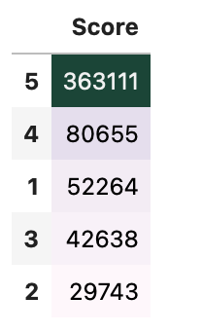
VISUAL EDA

Slide 14
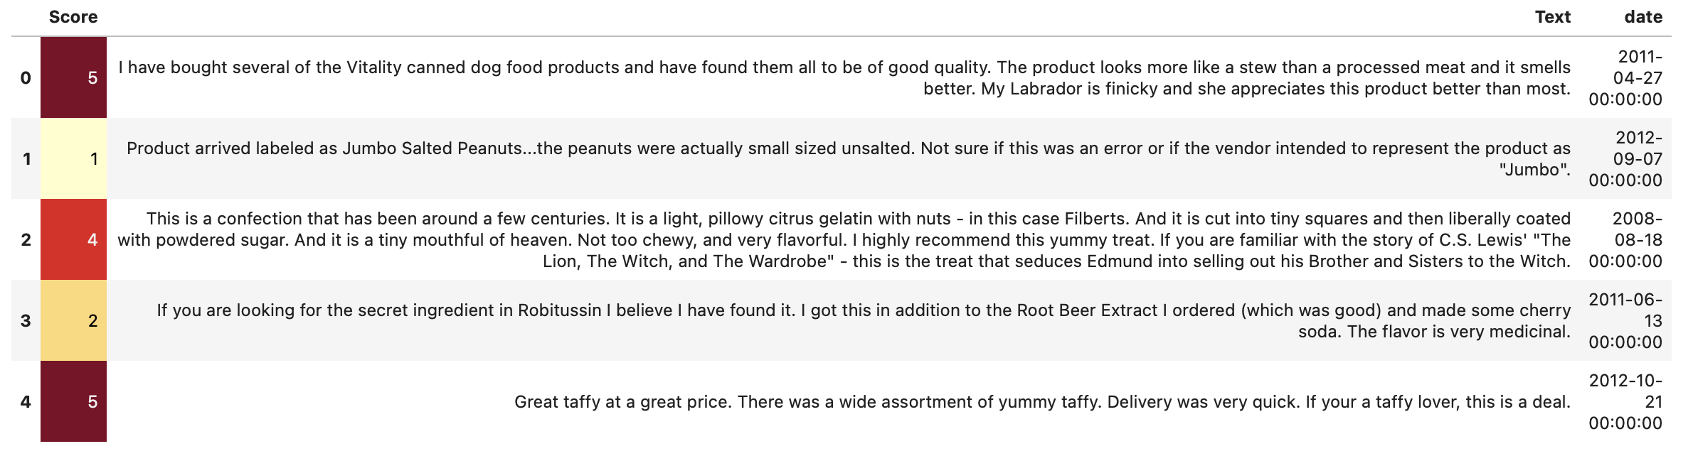
VISUAL EDA
EXAMPLE OF REVIEWS

Slide 15
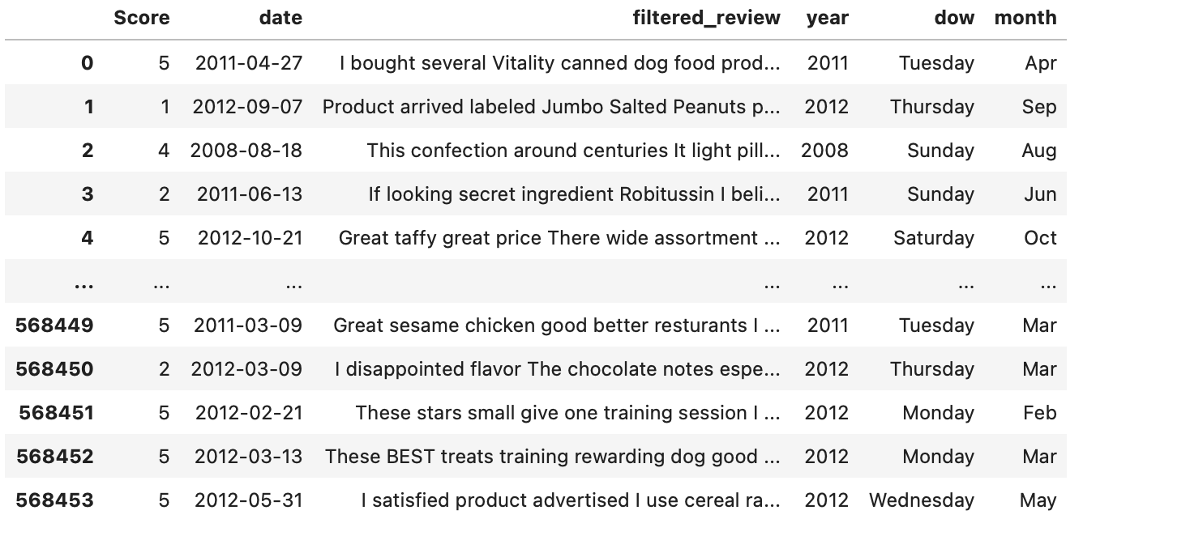
VISUAL EDA

Slide 16
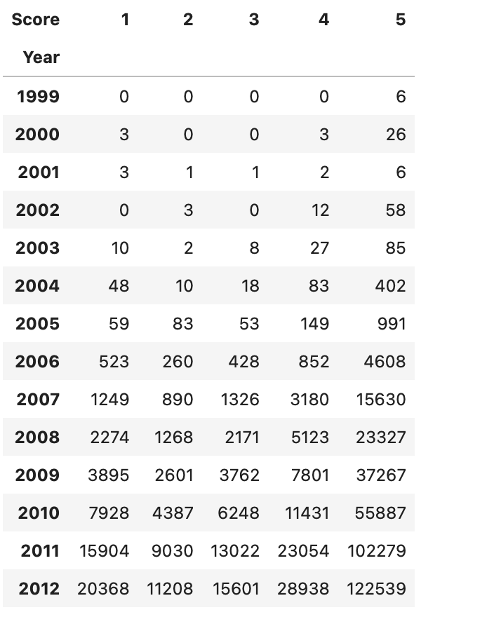
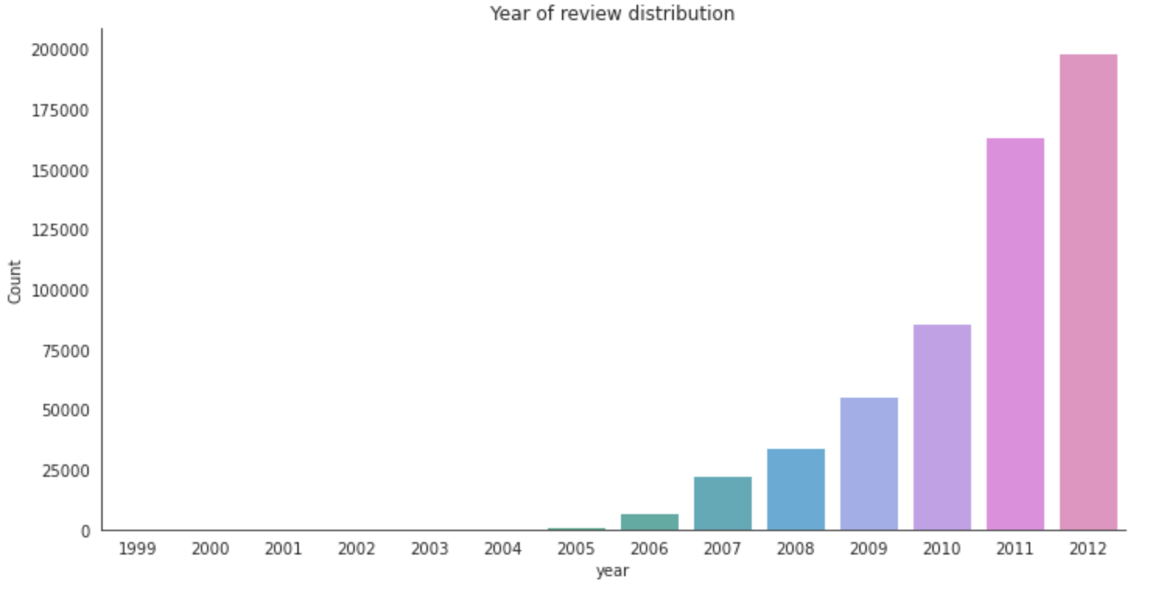
VISUAL EDA
YEAR DISTRIBUTION

Slide 17
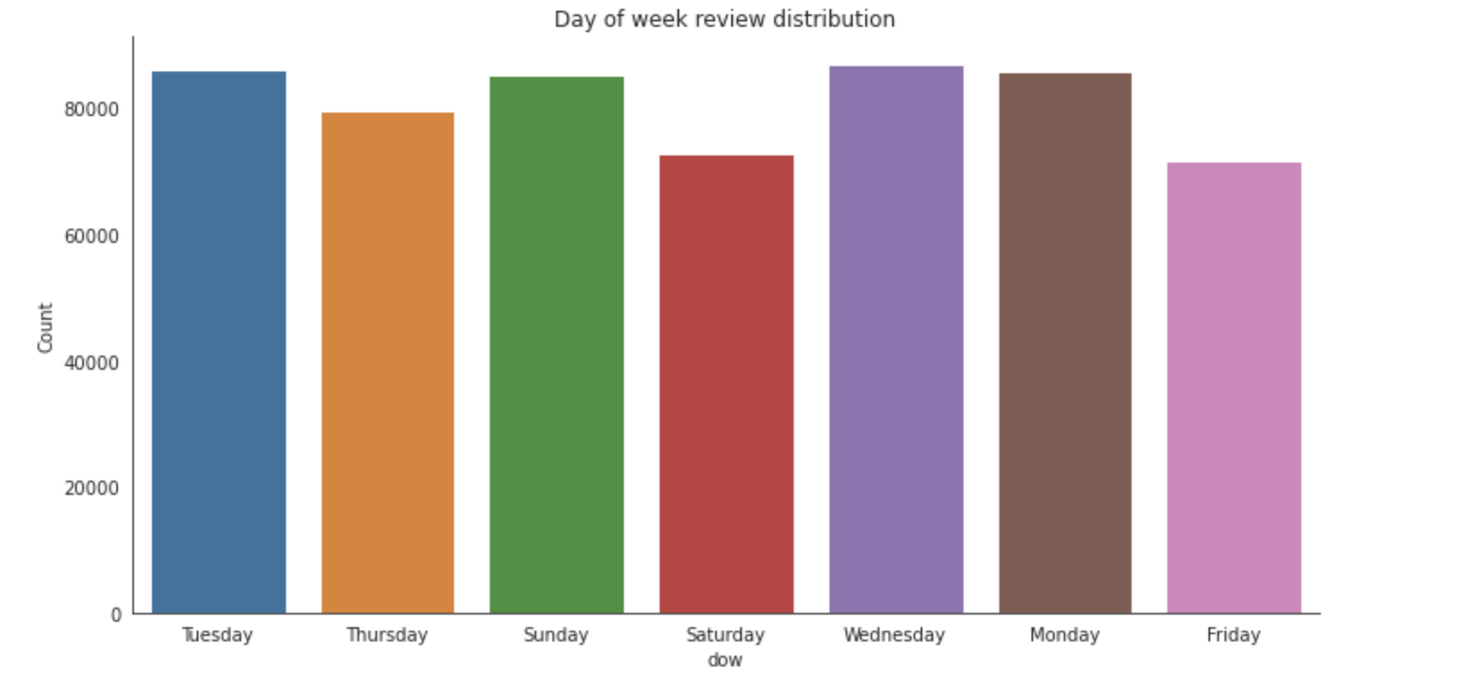
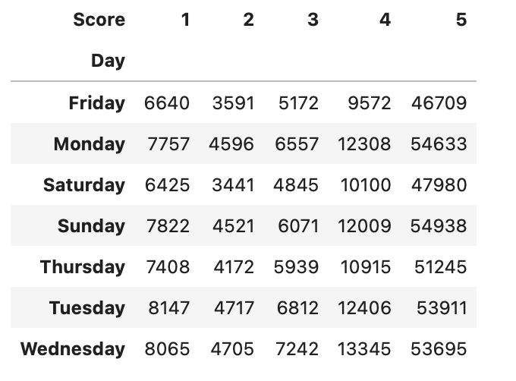
VISUAL EDA
DAY DISTRIBUTION

Slide 18
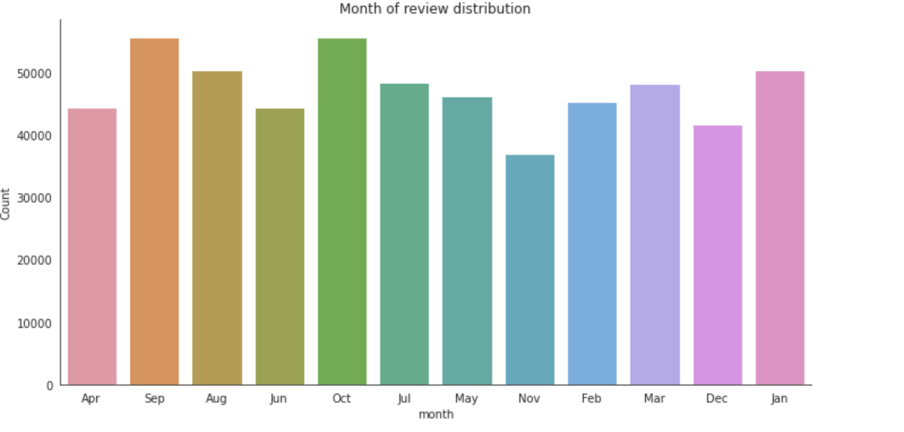
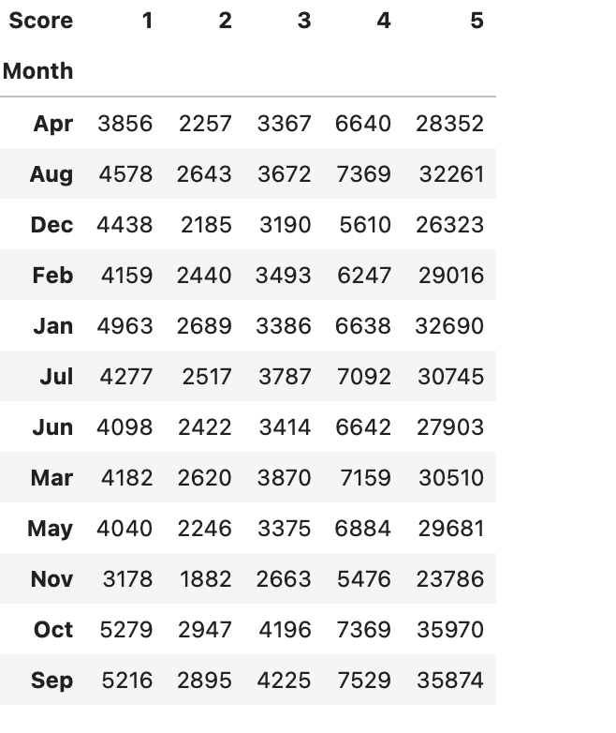
VISUAL EDA

Slide 19
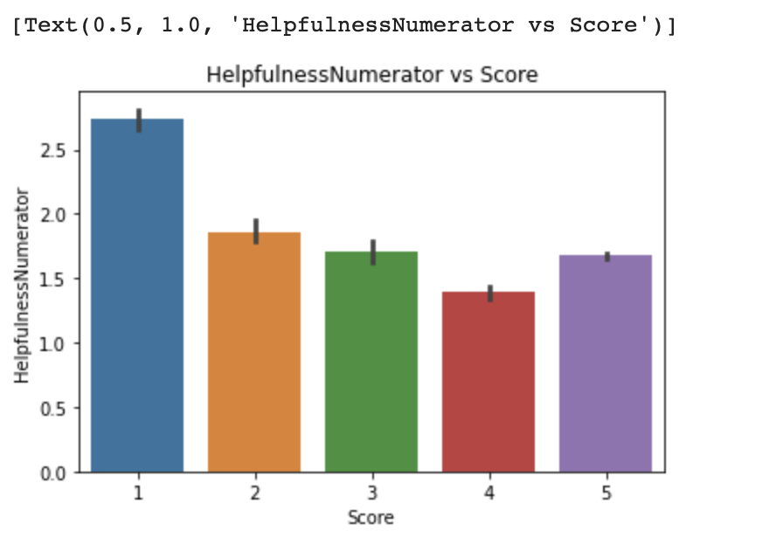
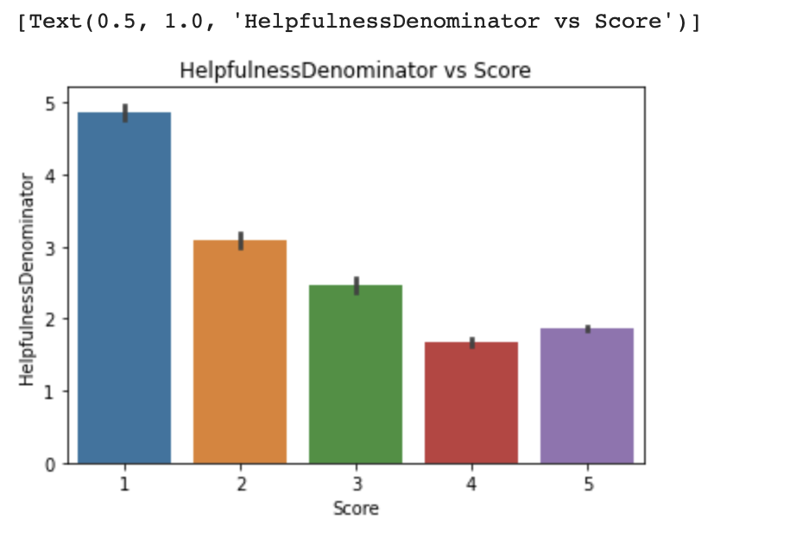
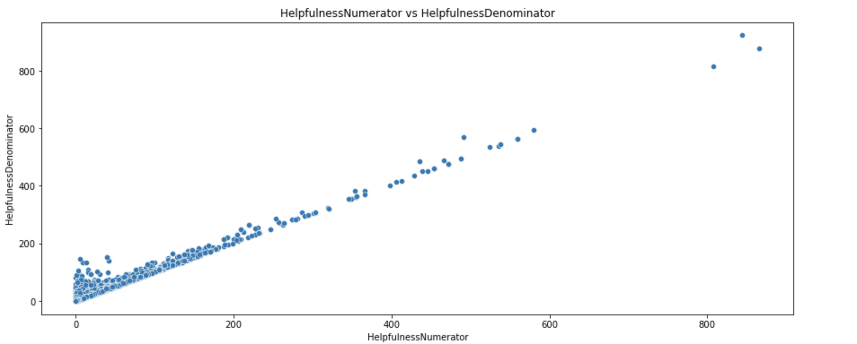
VISUAL EDA

Slide 20
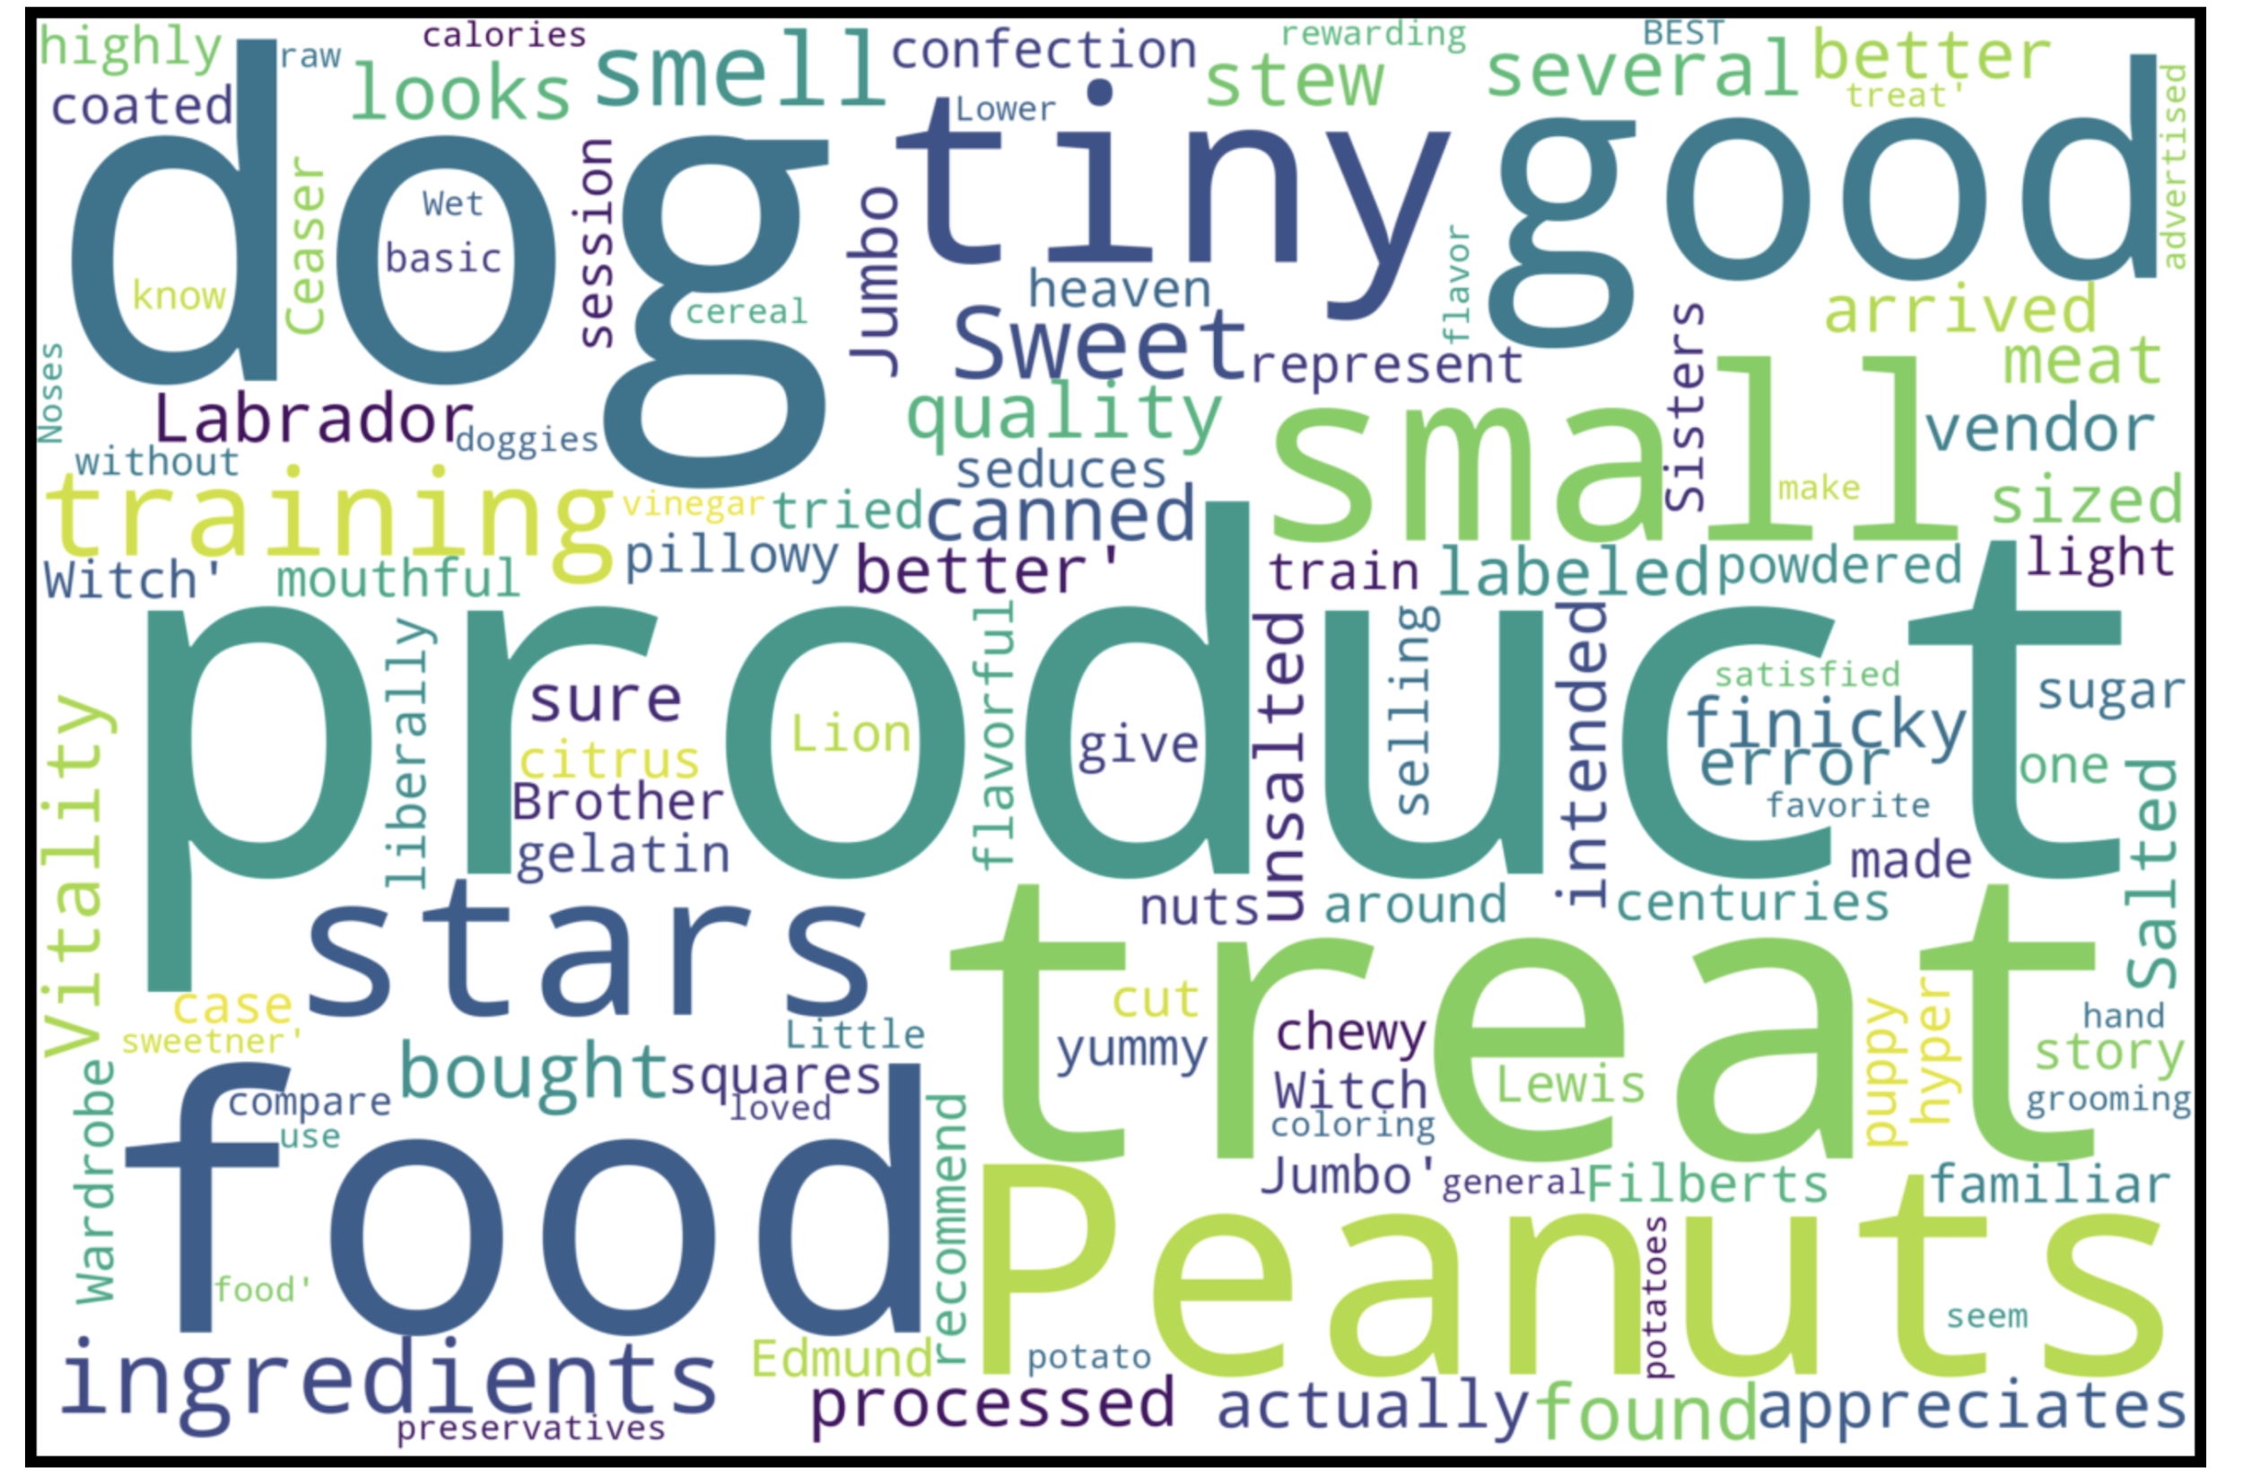
VISUAL EDA
Word Cloud

Slide 21

FEATURE
ENGINEERING
SECTION 5

Slide 22
FEATURE ENGINEERING
The date column in the data set was in integer timestamp format.
Made use of DateTimeIndex in Pandas to get the individual days of weeks, months and year when the reviews were submitted.
Created a new feature column with the converted normal datetime, that could be used to better understand the trends in the data

Slide 23
MODELLING
SECTION 6

Slide 24
MODELLING
After the above steps, created a matrix with UserId as row and ProductId as columns and score (rating) as the value.
Then created a similarity matrix using cosine similarity to identify similar users
The generated a set of 10 users that are similar to an user, based on their product ratings
This method is similar to collaborative filtering and would allow us to recommend product to an user based on other similar users.
The products that could be recommend to this particular user would be the ones that the other users have rated the best

Slide 25

ANALYSIS &
RESULTS
SECTION 7

Slide 26
ANALYSIS & RESULTS

Slide 27
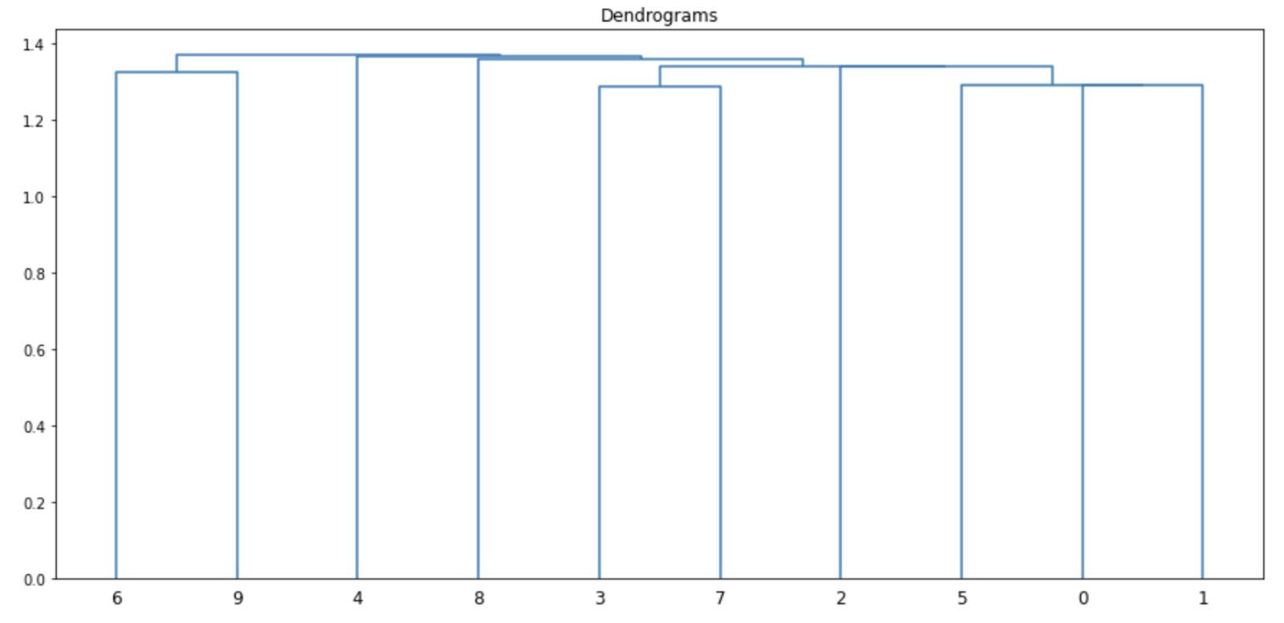
ANALYSIS & RESULTS
Single link clustering

Slide 28
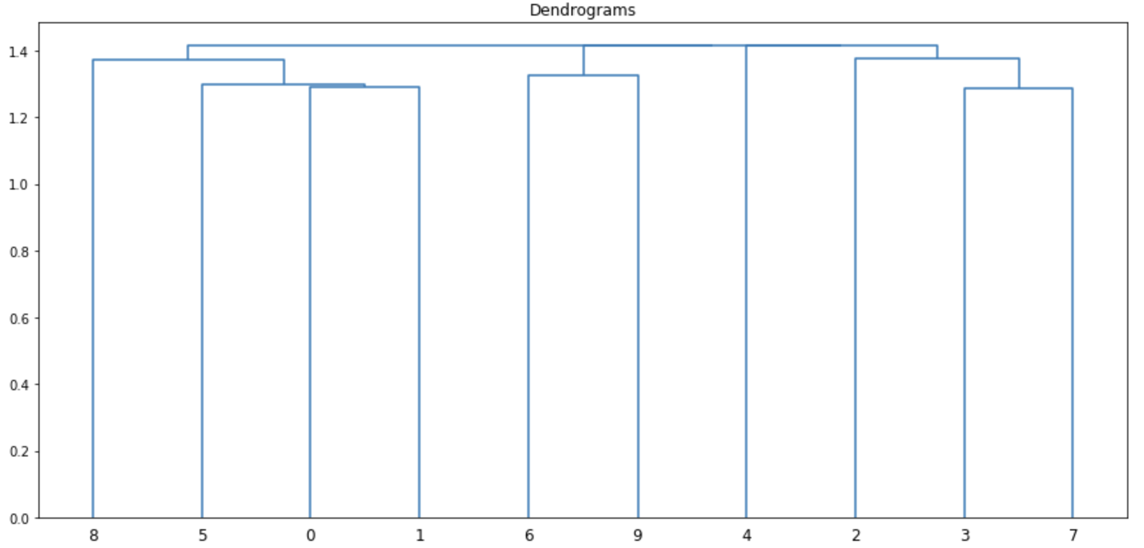
ANALYSIS & RESULTS
Complete clustering

Slide 29
PROBLEMS FACED
SECTION 8

Slide 30
PROBLEMS FACED
Size of the data was huge. This was a problem throughout the project
It was not feasible to calculate the similarity matrix using pivot option as it has some size limitation. This was a major difficulty. We tried to manually create a matrix, but that was very time consuming.
So to fix this, the only way was to drop data. But this has to done without inducing any bias in the system.
So we decided to pick a number of users by random sampling and drop them
Calculation of cosine similarity using entire reviews column was not possible due to memory issues.

Slide 31
CONCLUSION
SECTION 9

Slide 32
CONCLUSION
We were successful in analyzing and designing a personalized recommender system based on both content based filtering and collaborative filtering.
The recommendations were based on the past behavior of the user and also based on the other similar users.
The techniques learned from this project have multiple use cases and can be used on a variety of datasets to recommend meaningful products and services to the end users.

Slide 33
FUTURE SCOPE
SECTION 10

Slide 34
FUTURE SCOPE
Will be using models like SVD, NMF, SVD++ in the future, to optimize for better results.
We will be implementing hyper parameter tuning for the best model
We will also be implementing content based filtering
Also, we will be trying to implement CNN based models

